Slide 1
Learning and Using R to support front end staff
Lori Edwards Suarez
https://analystinthewild.wordpress.com/

Slide 2
Introduction
Clinical Development Unit Nottinghamshire Healthcare NHS Foundation Trust
MSc Bioinformatics with Molecular Genetics
Liaison Psychiatry has 2 main aspect
1. Emergency Liaison
2. Outpatient Appointments

Slide 3
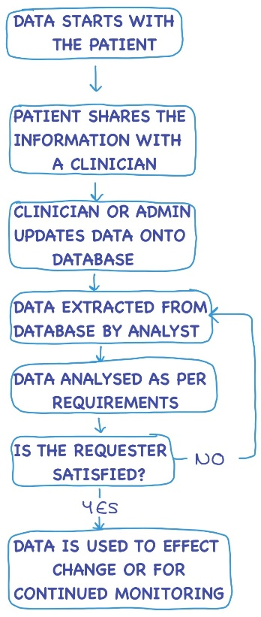
Data Flow Chart
Most analysts focus on data from extraction to making sure the referrer is satisfied
Data journey is much more complicated that often appreciated

Slide 4
Start of the Process
Provide Context
Understand the clinicians interpretations
Amending Data Collection
Simplifying the Process

Slide 5
End of the Journey
Endless Loop
Reproducibility/Reliability
Use of Data
Audience
What the Data Shows

Slide 6
Grep – for reproducibility
Data$Staff
Groupings
Code
Aggregating Staff
Dr Alpha
Dr Bravo
Mr Charlie
Miss Delta
Mrs Echo
Dr Foxtrot
Dr Golf
Mr Hotel
Ms India
Dr Juliet
Dr Kilo
Dr Lima
Dr Mike
Dr November
Liaison Team
Dr Alpha
Mr Charlie
Miss Delta
Mrs Echo
Dr Golf
Mr Hotel
Ms India
Dr Kilo
Dr Mike
Everyone else is On Call
Data$Team = “Liaison“
Data$Team[grep(“^Dr”, Data$Staff)] = “On Call“
Data$Team[grep(“Alpha”, Data$Staff)] = “Liaison"
Data$Team[grep(“Golf”, Data$Staff)] = “Liaison"
Data$Team[grep(“Kilo”, Data$Staff)] = “Liaison“
Data$Team[grep(“Mike”, Data$Staff)] = “Liaison“

Slide 7
Data Literacy

